Slide 1


Project Marthon Project NAme :-Dog House
Under the Guidance of Prsented by
Vignesh Sir Ashutosh Sapkal
MuthuKumar Sir

Slide 2
Introduction
Good day, everyone! I'm thrilled to welcome you to our presentation, where we'll explore the exciting world of our newly created doghouse website.In a digital landscape where our love for dogs knows no bounds, we decided to build a virtual haven for fellow dog lovers. Our website is not just a project; it's a passion brought to life. It's a place where wagging tails, furry friends, and the warmth of doghouses come together.Today, we'll take you on a tour of this website, designed to be the ultimate destination for dog enthusiasts, owners, and those seeking a wealth of information on our loyal companions. Our website encapsulates the essence of our four-legged friends, offering a unique and enriching experience.Throughout this presentation, we'll showcase the website's key features, user-friendly design, content strategy, and how it caters to the needs of the dog-loving community. We'll also touch on our future plans and engagement strategies.This website is more than just digital space; it's a tribute to the bond between humans and their furry companions. We believe you'll find it engaging, informative, and a source of inspiration. So, let's embark on this journey and dive into the world of dogs within our virtual doghouse. Thank you for joining us today.

Slide 3
Abstarct
*Dog Adoption Form*: The inclusion of an adoption form indicates a commitment to facilitating dog adoptions, fostering responsible pet ownership, and connecting potential pet parents with furry companions in need. This emphasizes the website's role in promoting animal welfare
*E-commerce Products*: The e-commerce section adds a practical dimension to the website, offering a marketplace for pet-related products. Whether it's dog accessories, supplies, or merchandise, this feature provides both convenience for visitors and potential revenue for the website.
*Image Carousel*: The use of a carousel effect on images demonstrates a dynamic and visually engaging design. It's an effective way to showcase various aspects of your website, from dogs available for adoption to featured products, keeping the user experience fresh and visually appealing.
*Dog Information*: The presence of informative content about dogs is crucial. This content can educate visitors, promote responsible dog ownership, and create a sense of community among dog lovers. Well-researched, accurate, and engaging content enhances the credibility and value of the website.

Slide 4
Objective
To create a comprehensive and user-friendly online platform that offers a wide range of quality dog products while providing valuable information, tips, and resources to help dog owners care for their furry companions effectively and enhance the overall well-being of dogs.

Slide 5
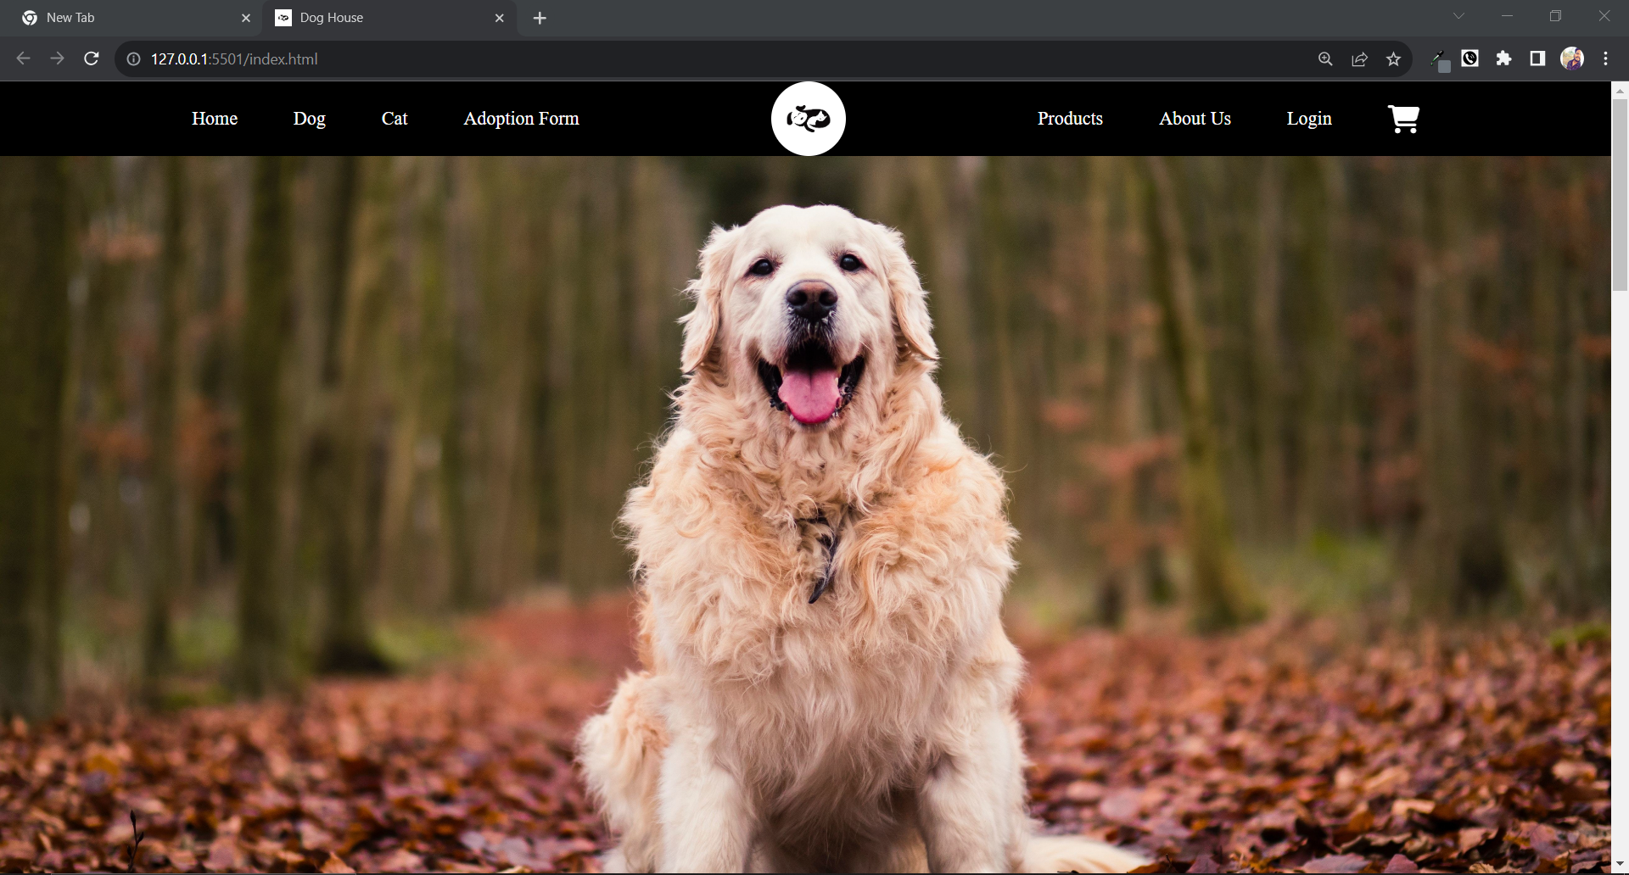
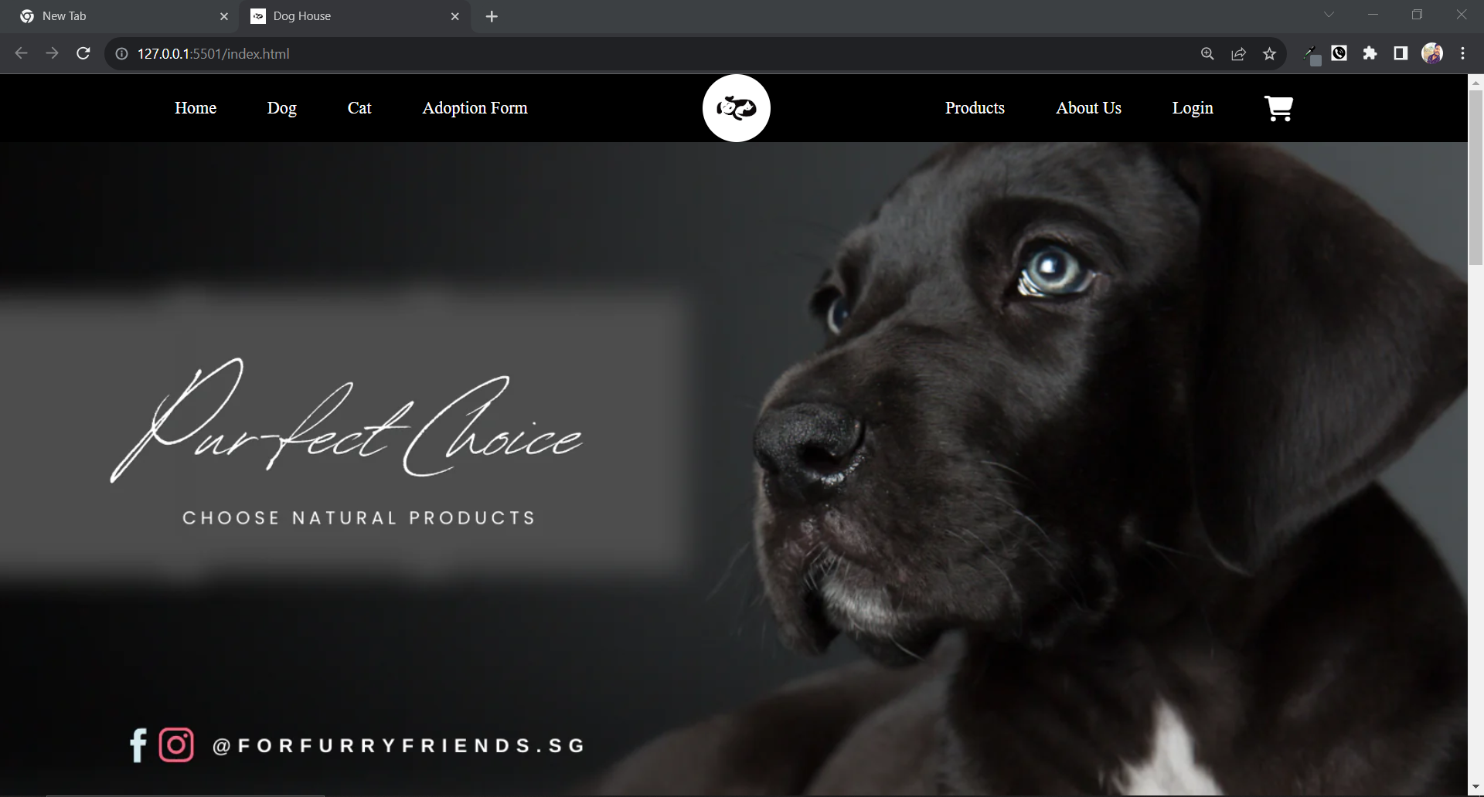
1st Page
In this page we can see the “Navbar” And One “Carosoul Effect” which is autoplaying
Attarction of this Page:-A circular image in Navbar And Carosoul Effect

Slide 6
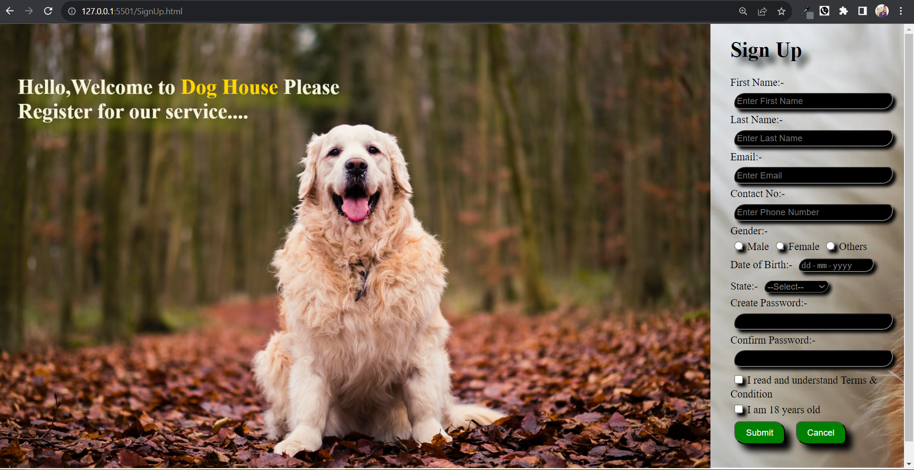
Signup PAge

Slide 7
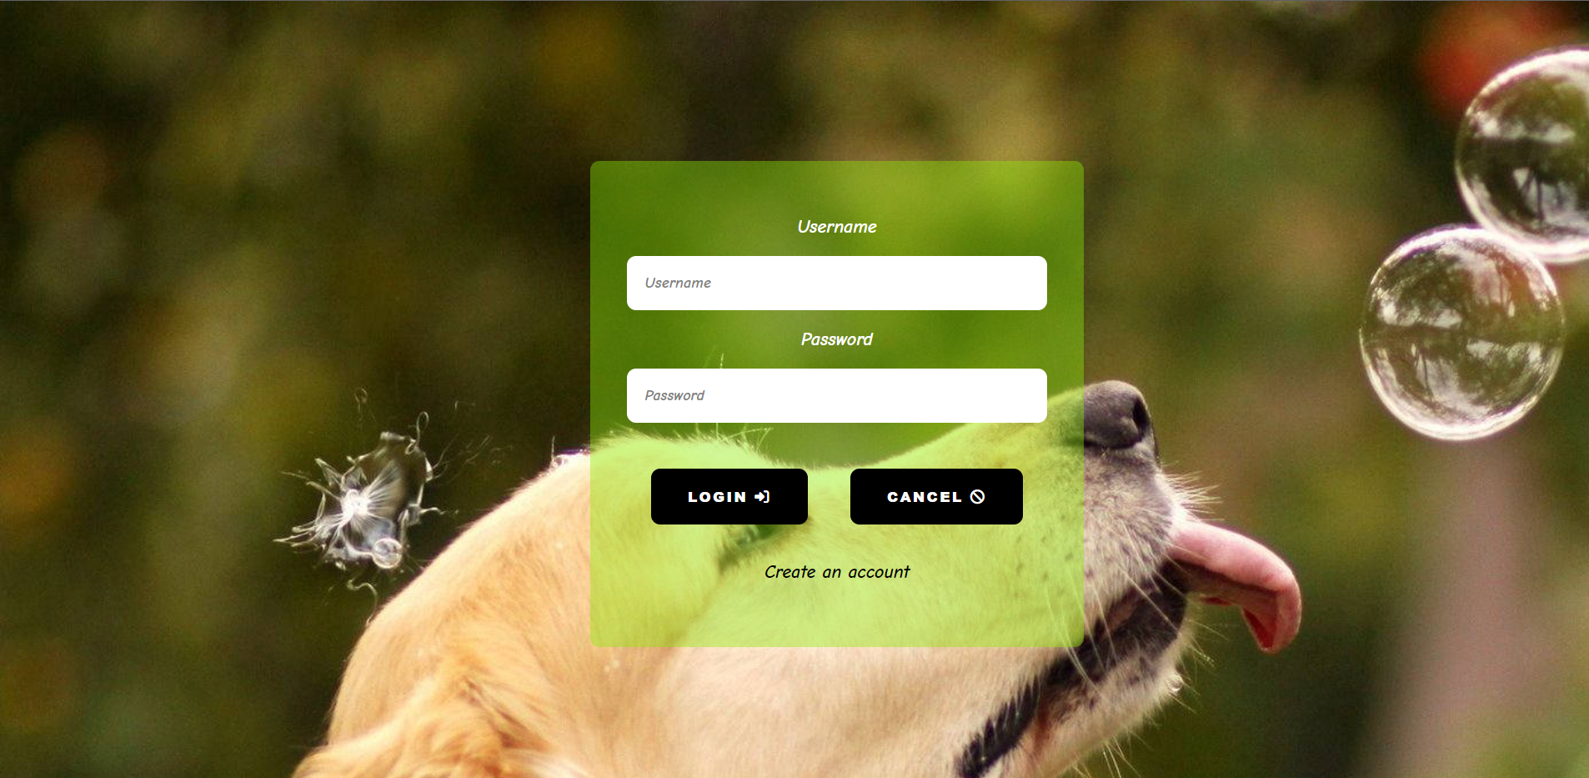
Login PAge

Slide 8
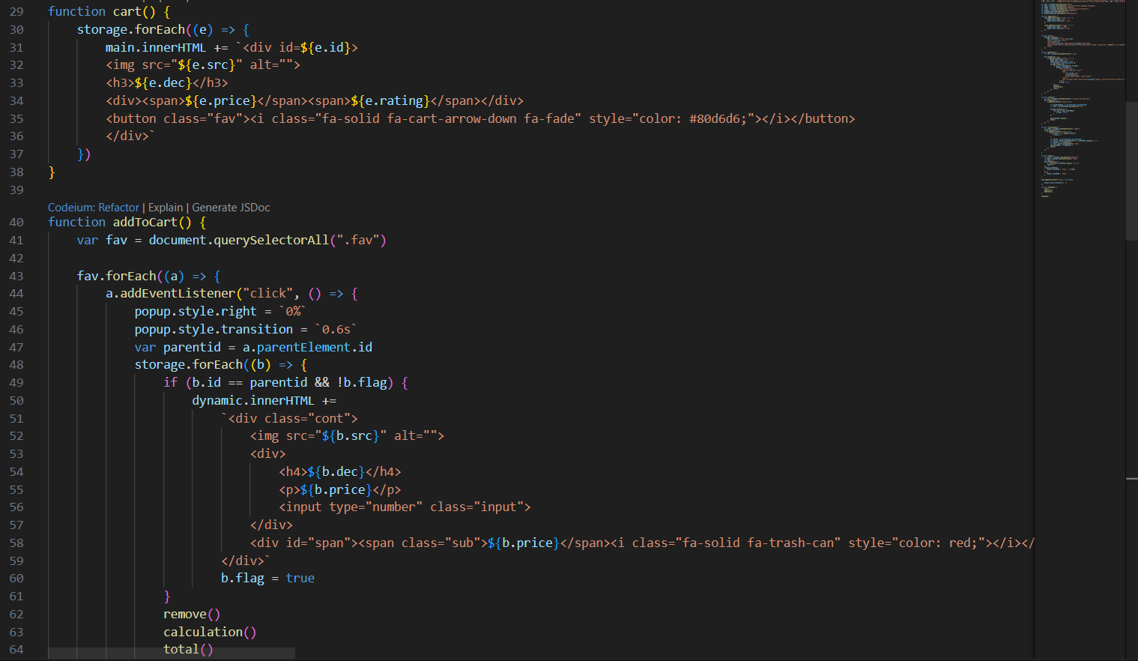
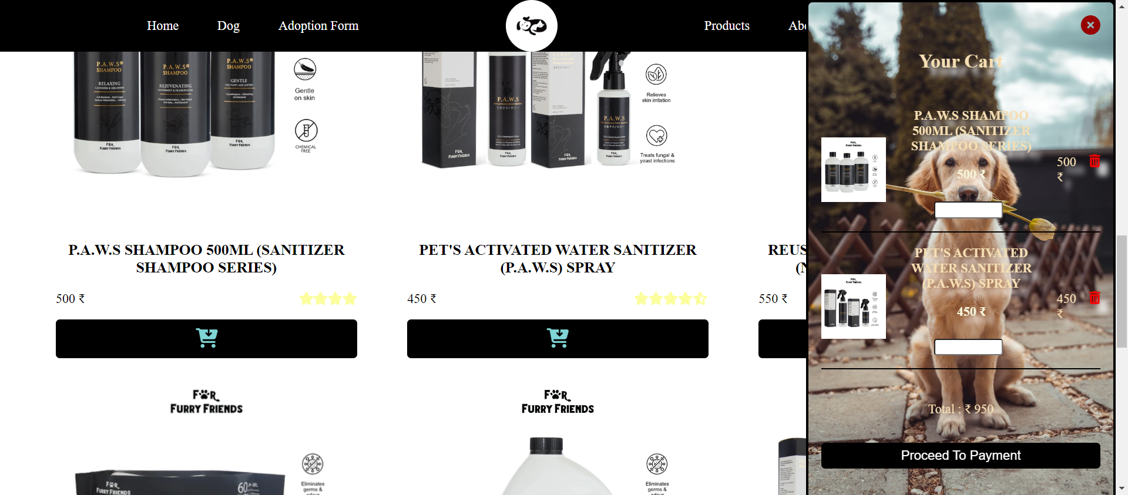
CArt

Slide 9
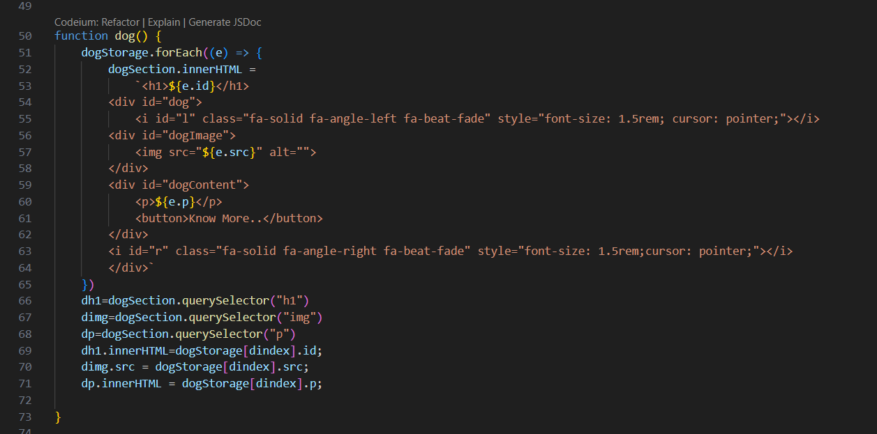
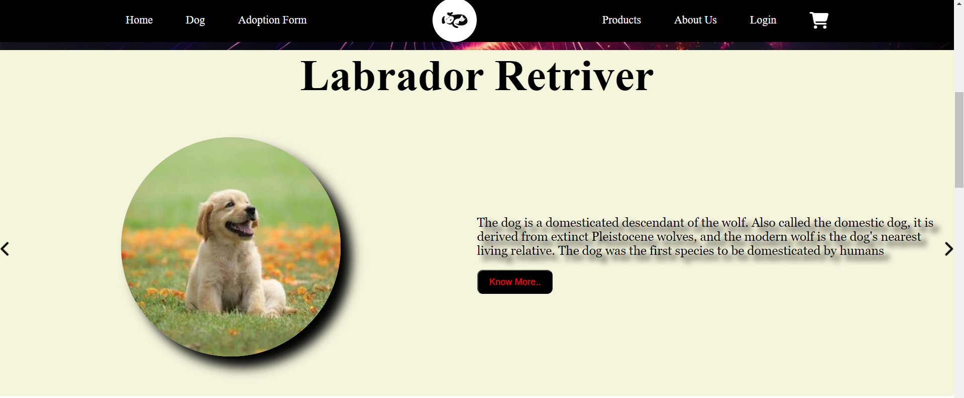
Dog Section

Slide 10
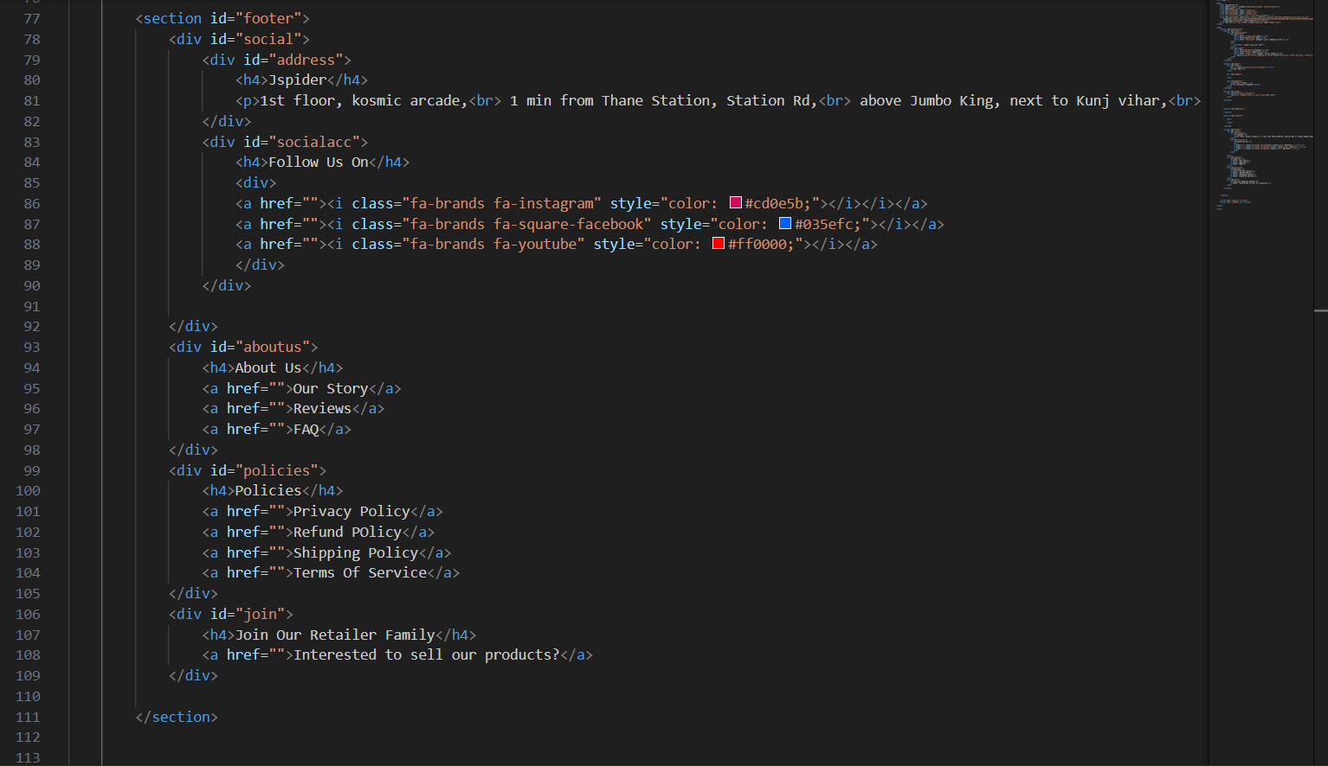
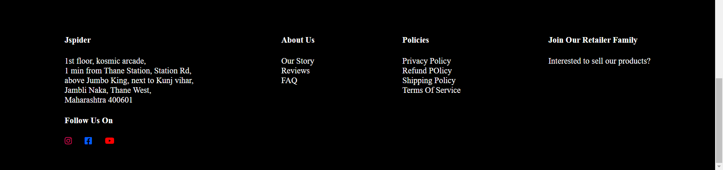
Footer

Slide 11
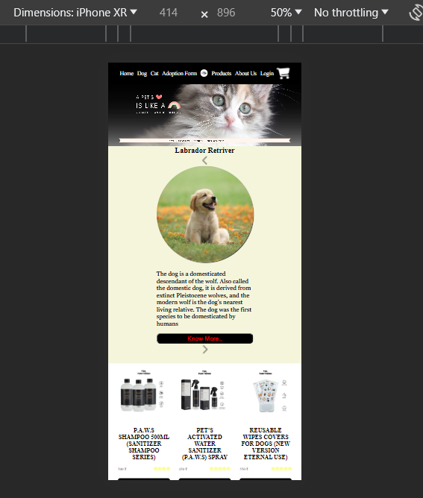
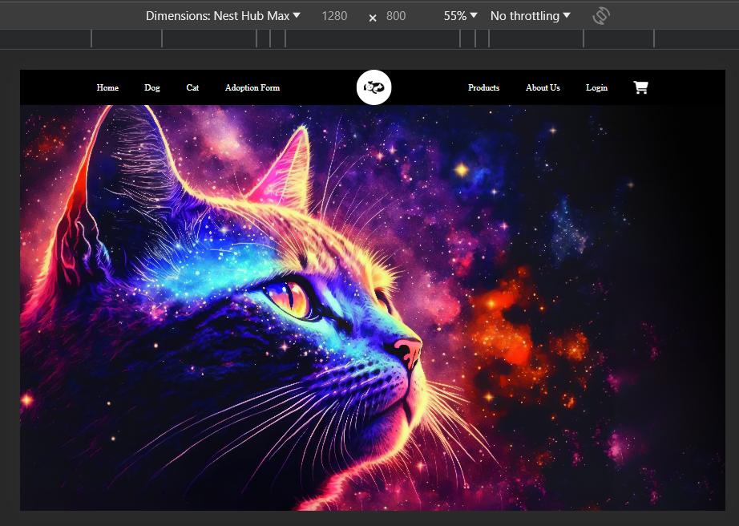
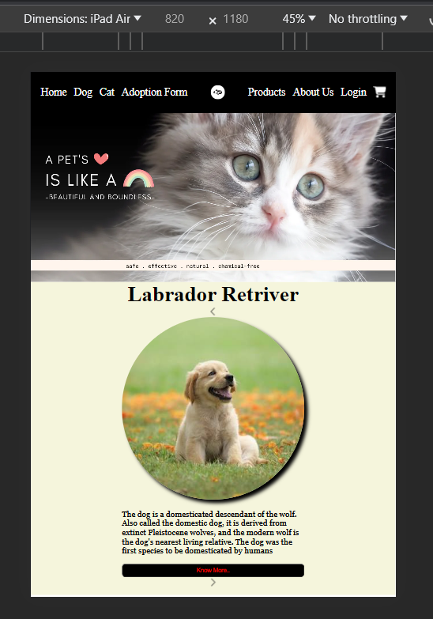
REsponsivness
Ipad air,NestHub
Iphone xr

Slide 12
Technoligies Used
html:- tags:- header,main,section,div,p ,id,class,a,img,i
Css:- Attributes:- margin,padding,overflow-x,width,height,font-weight,text-decoration,color,background-color,z-index,dispay,justify-content,align-items,gap,position, ,object-fit,box-shadow,text-shadow,border-radius, transition,transform:rotate,back-gound
Css responsivness:-@media,@keyfrmes
javascript:- dynamically created the html part and change the innerhtml using js

Slide 13
Refrence
Photos :-Furry Friend ecommerce Website
Content:-Google Wekipedia
Adoption Form:-https://www.jotform.com/form-templates/dog-adoption-application
Icons:-Font Awesome

Slide 14
Conclusion
Our dog-focused website strives to be a one-stop destination for dog lovers. By offering a diverse range of high-quality products for dogs, we aim to make pet care more convenient and enjoyable for owners. Additionally, our commitment to providing informative content ensures that visitors can access valuable knowledge to keep their canine companions happy and healthy. We look forward to being your trusted resource in the world of dogs.

